Slide 1
LABEL STUDIO TUTORIAL
Implementation in the Linux OS

Slide 2
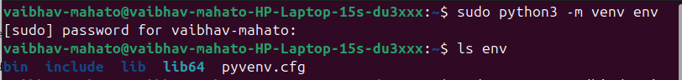

Run the terminal Ctrl+Alt+ T
We have to run ' python3 –m venv env ' which typically means to create a virtual environment for python to run .
TO CHECK WHETHER VIRTUAL ENVIRONMENT IS RUNNING OR NOT – Run Command 'Ls env'
If it shows folders like bin , lib, and include , then the virtual environment was created properly

Slide 3
2. After sucesufully running the previous command Run 'source env/bin/activate'
is used to activate a Python virtual environment.
Let me break it down for you:
env/ is the directory where your virtual environment lives. Sometimes people name it venv/, .env/, or anything else.
bin/activate is the script inside the virtual environment that sets environment variables to "activate" it.
source is a shell command that runs the script in the current shell, so the changes (like modifying the PATH) stick around.

Slide 4

What happens when you run it?
When you activate a virtual environment:
Your terminal's prompt usually changes to show the virtual environment's name.
The python and pip commands point to the ones inside the virtual environment, not the global ones.
You can install packages that will only exist within this environment.

Slide 5
3. ' sudo apt install python3.9-dev '
means you're telling your system (specifically a Debian/Ubuntu-based Linux system) to install development headers and files for Python 3.9.
Here's a breakdown:
sudo: Runs the command as a superuser (admin), since installing packages requires elevated permissions.
apt: The package manager for Ubuntu/Debian systems.
install: Tells apt you want to install something.
python3.9-dev: The actual package you're installing.

Slide 6
4. 'python -m pip install label-studio'
it means:
You're telling Python to:
-m pip: Run the pip tool (Python’s package installer) as a module.
install label-studio: Download and install the Label Studio package from the internet (specifically from PyPI).

Slide 7
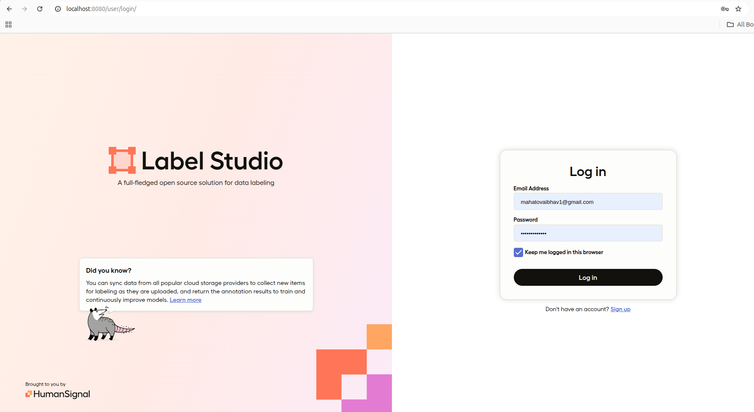

How to start project work in label studios ?
Ensure that label studio is running locally which was installed in your system.

Slide 8
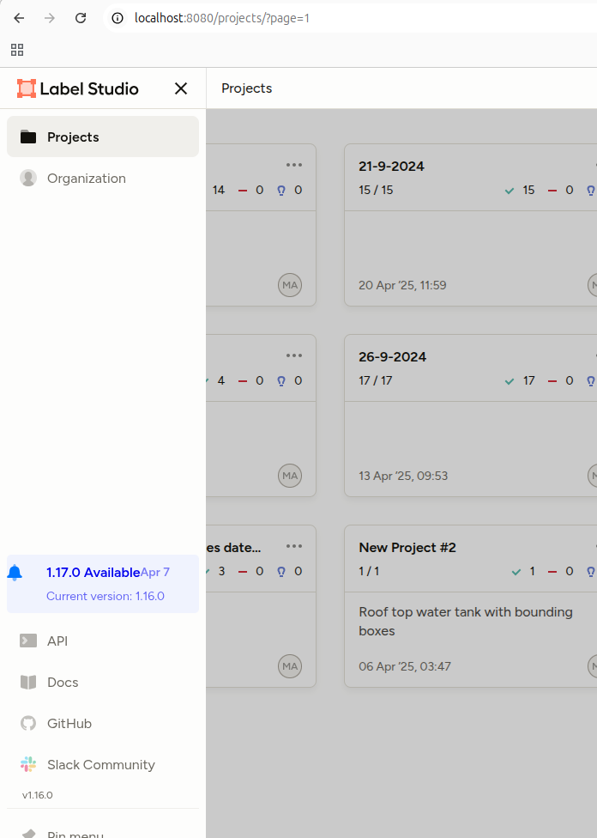
I.After login , we go to the projects section by clicking on the top left corner three vertical lines.

Slide 9
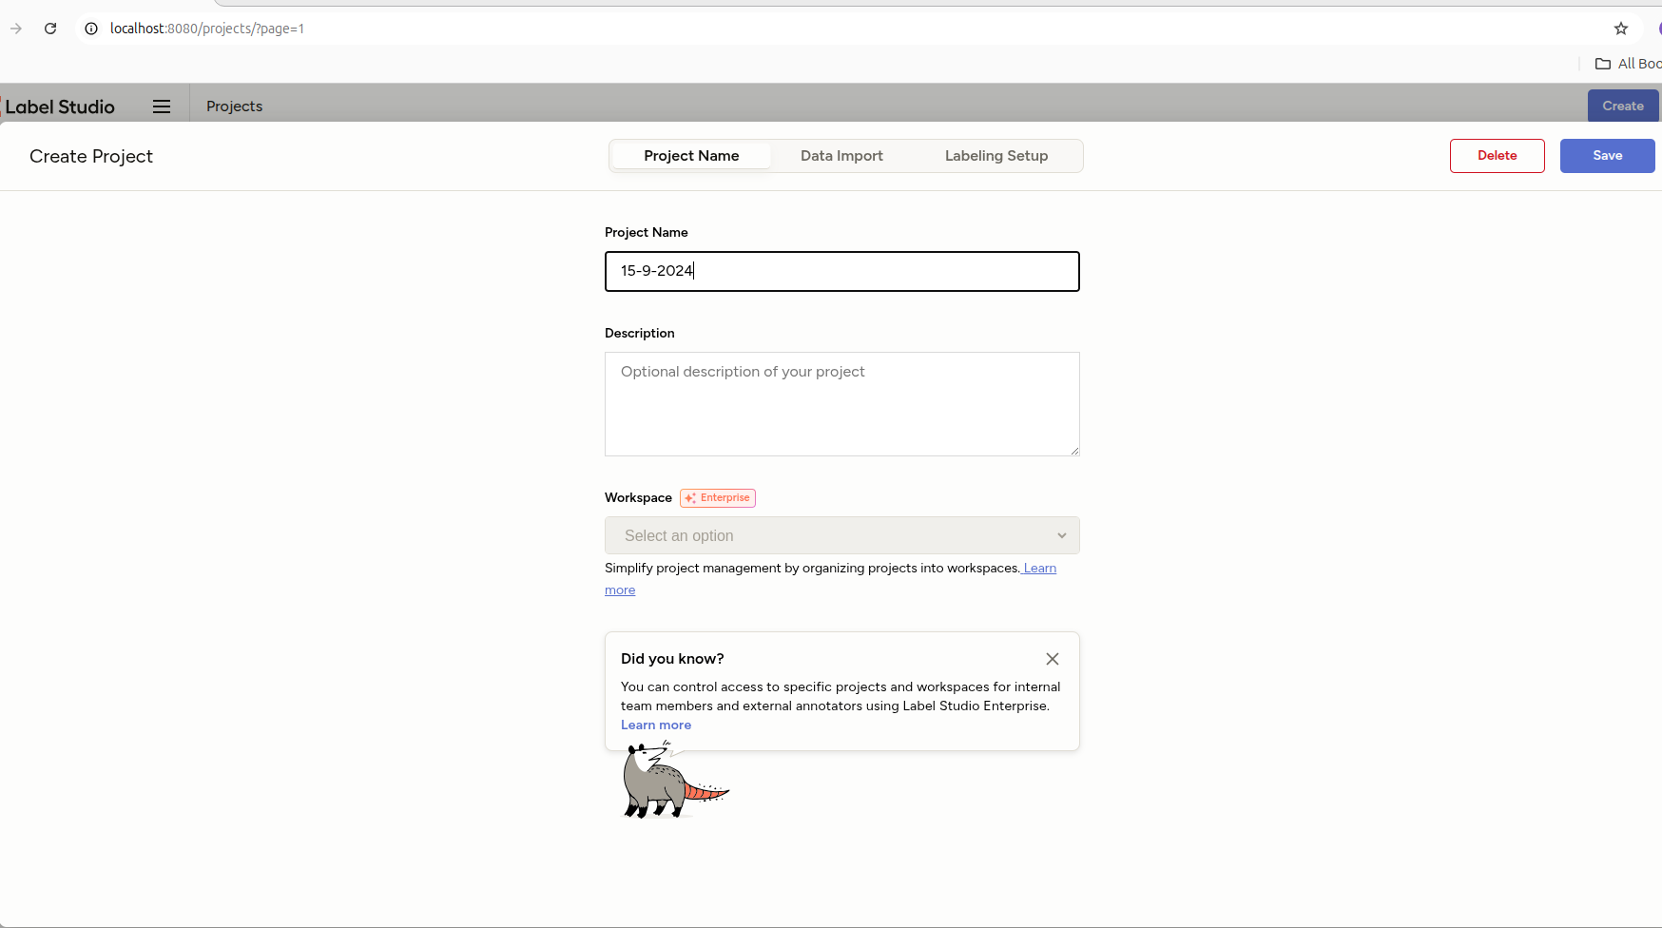
Then we moved on to the top right corner and clicked on the 'create' option. A new interface gets opened which is shown below and we fill the details in the first page of that interface (Project Name). For example I have filled my project name as 15-9-2024. Any additional information should be filled in the description section .

Slide 10
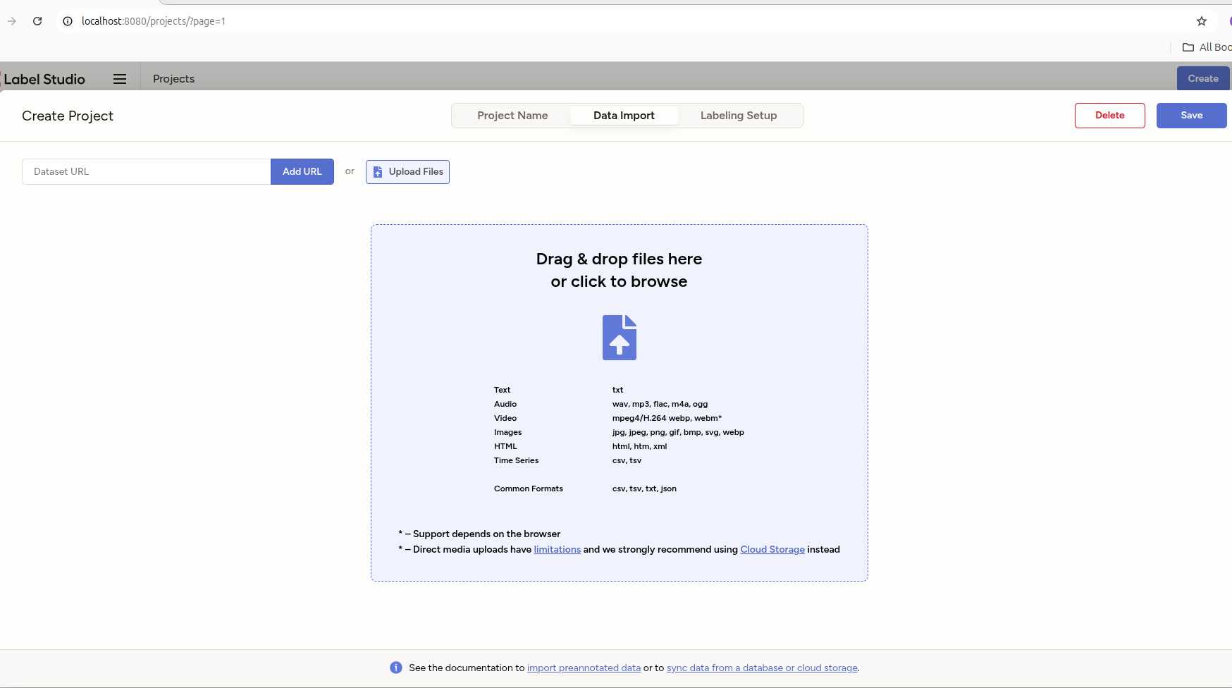
We then moved in the next interface by just clicking on the Data Import, and on clicking the add URL or Import Files we bring the files or JPGs in which annotation works need to be done.

Slide 11
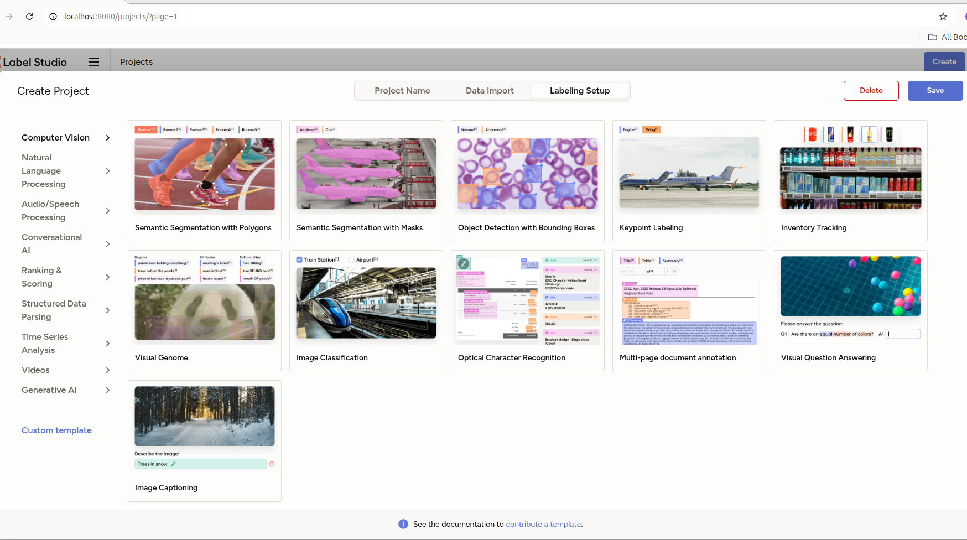
Then we move on to the next interface by clicking Labelling Setup and in the opening page itself we get different options to choose in which domain we are working and what kind of annotation we want to perform . For example, I choose Computer Vision and under it Semantic segmentation with polygon.

Slide 12
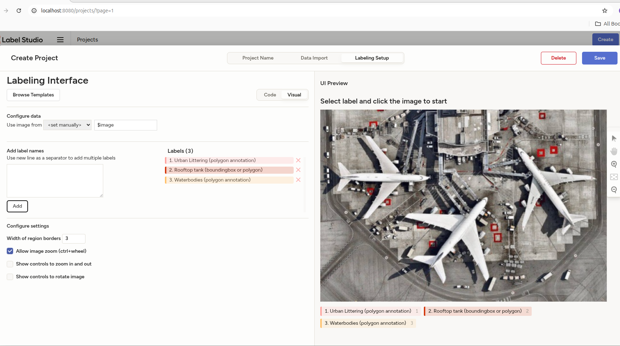
And when I clicked on what kind of work I want to do then it opens a interface as shown below.

Slide 13
In the add labels section we added different categories of annotations that you want to do and click on add. For example I added three categories of annotations I want to do on any image.

Slide 14
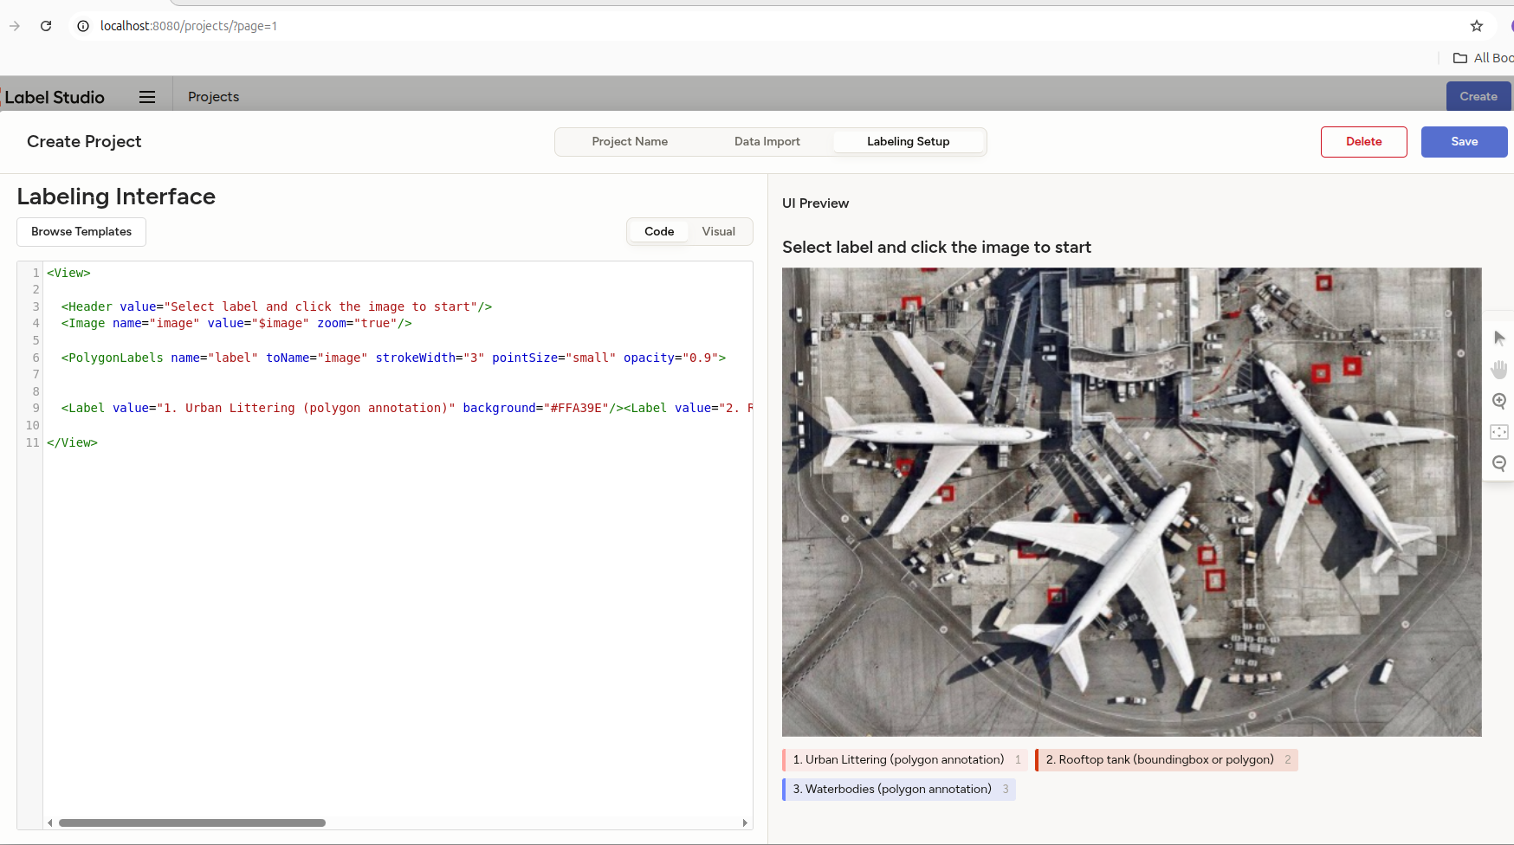
OPTIONAL : We can also write code for adding annotations and this can be done on clicking in the code section of the 'Labelling Setup'.

Slide 15

And then we click on the Save option in the top right corner , hence finally saving our project.

Slide 16
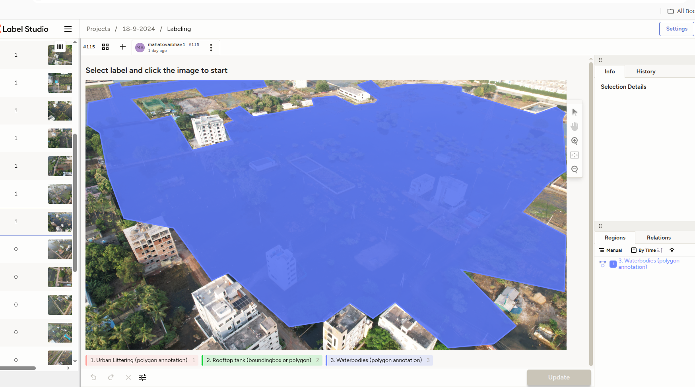
I have shown a sample image of my annotation work and then clicked on the update button in bottom right corner of the annotated image.

Slide 17
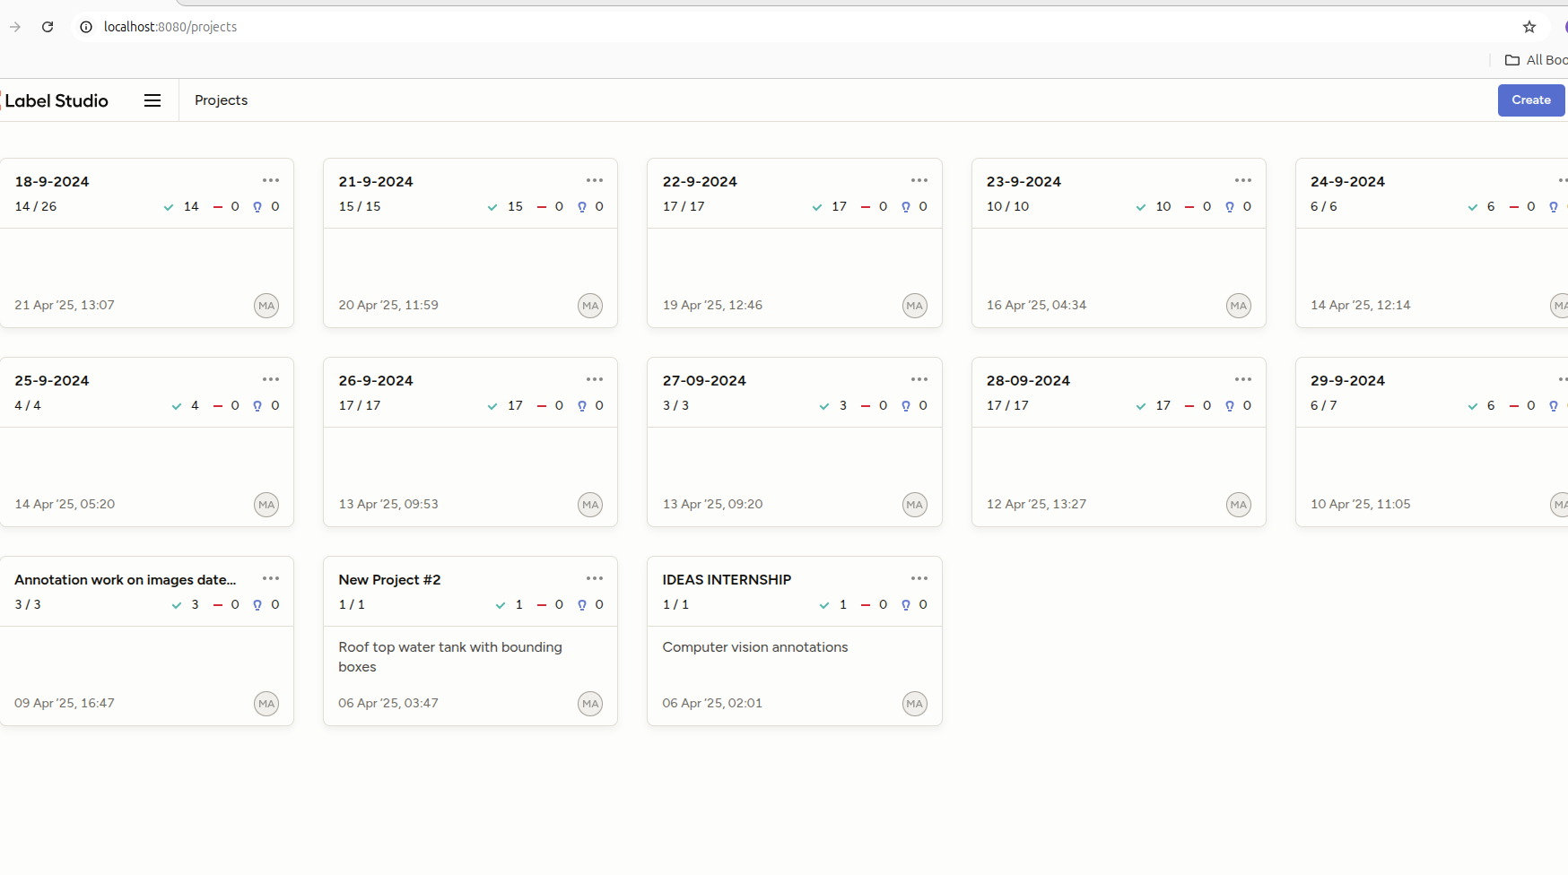
FINALLY THE DATA BASE COULD LOOK LIKE THIS.

